Slide 1
GOV.UK: Tariff commodity code look-up
Identifying ‘waiver document codes’ within measures
This is an example you can share with your clients showing how goods which may be subject to common prohibitions and restrictions (CITES, seal products and cat and dog fur) should be declared.

Slide 2
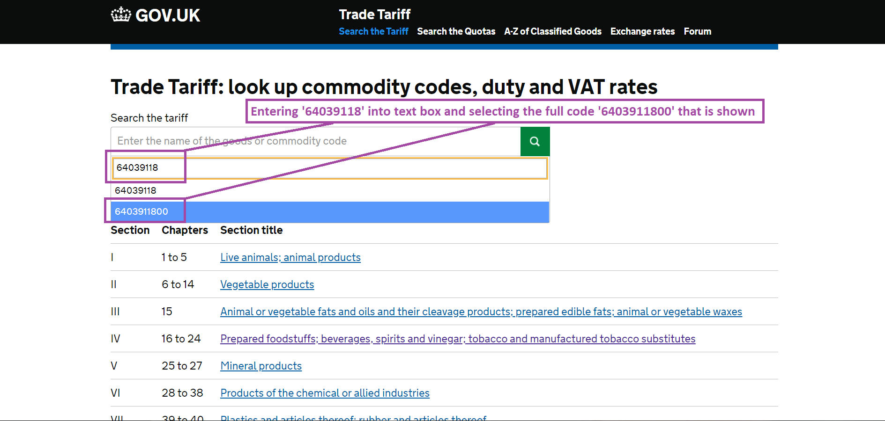
Enter the commodity code that you are using

Slide 3
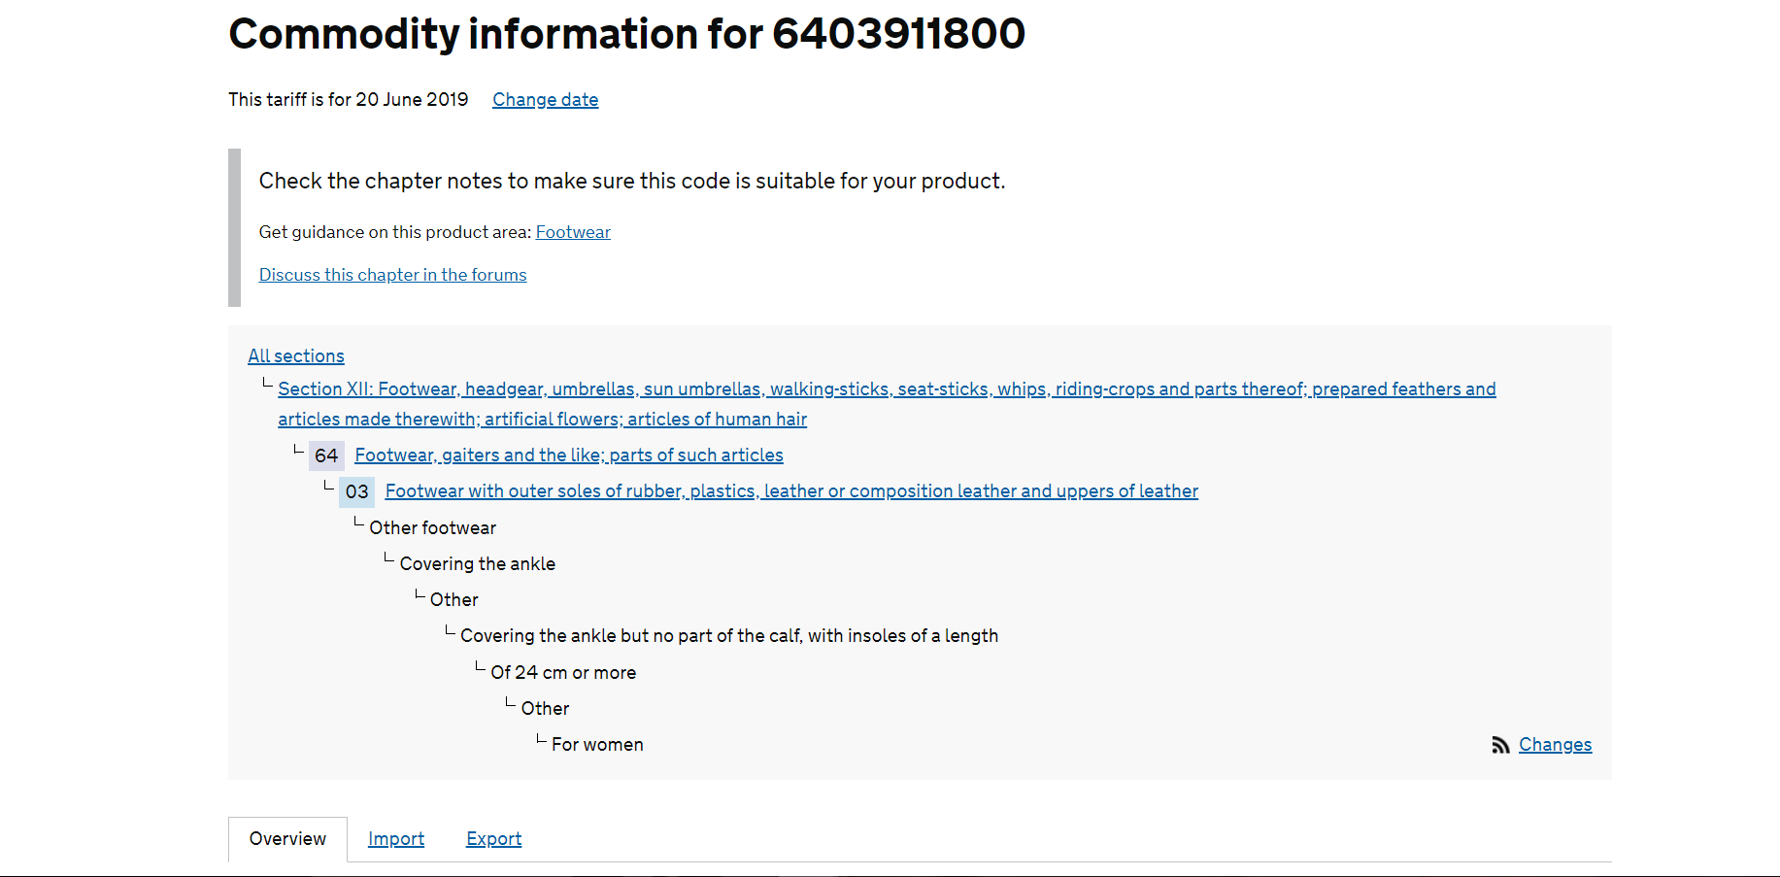
Full commodity ‘path’ for 6403911800

Slide 4
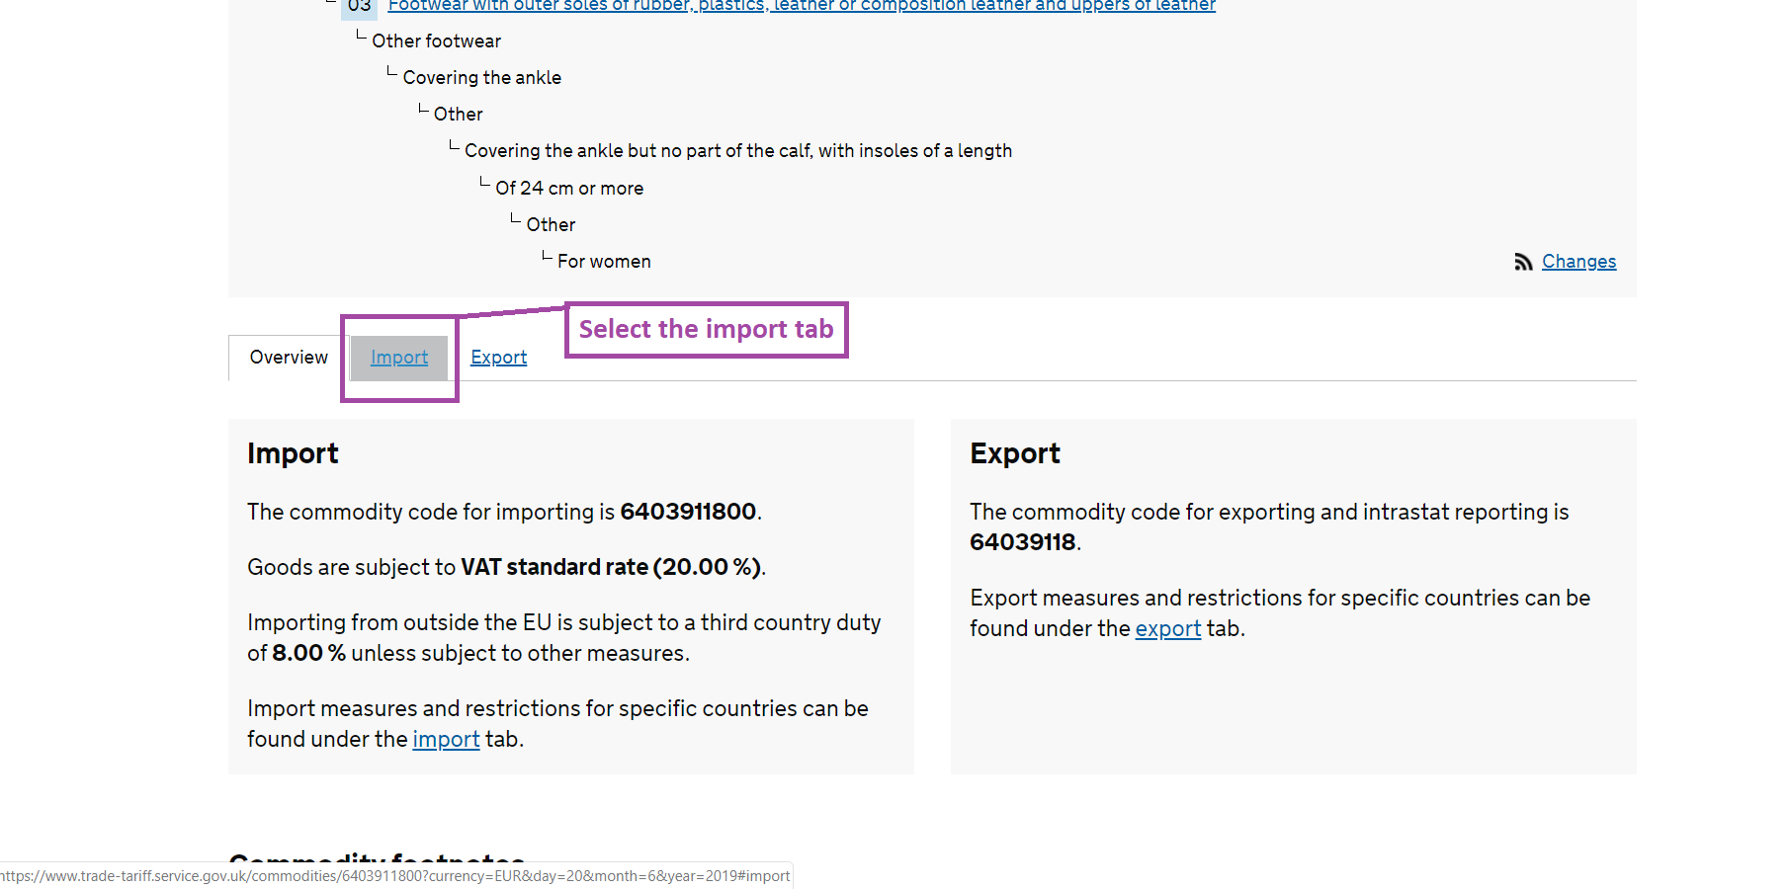
Select the ‘Import tab’ for further detail

Slide 5
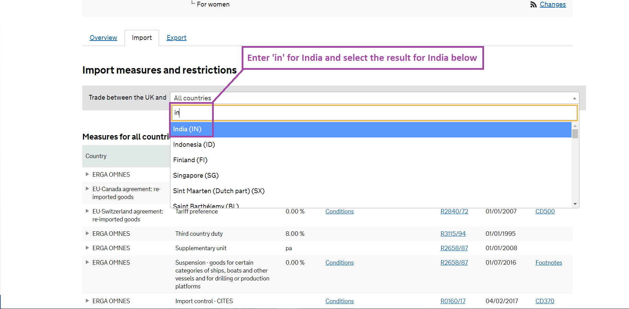
Enter ‘India’ for all information on trade with India

Slide 6
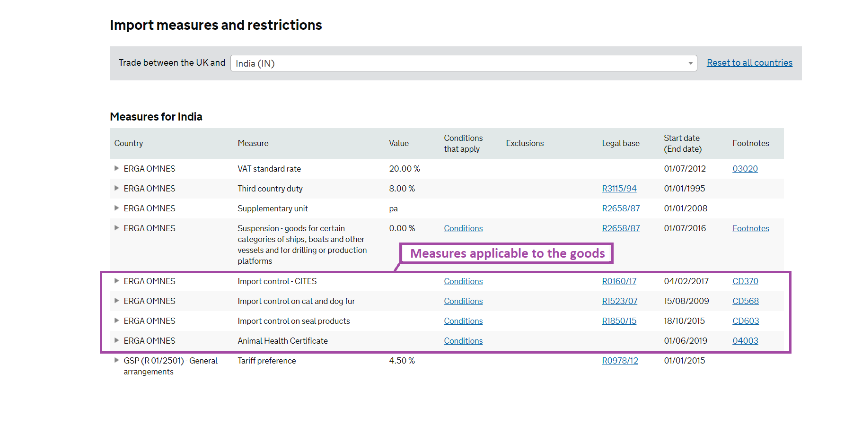
All information on India
(Note that ‘Erga Omnes’ means these apply to all countries)

Slide 7
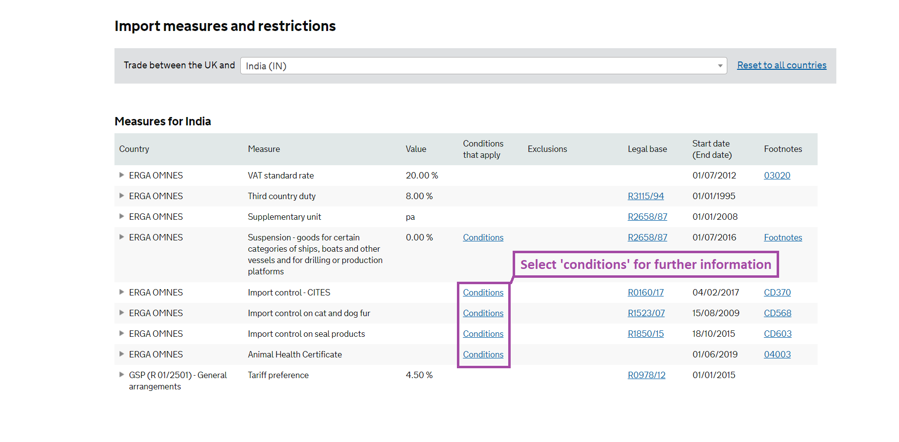
Select ‘Conditions’ to see further detail on the measures

Slide 8
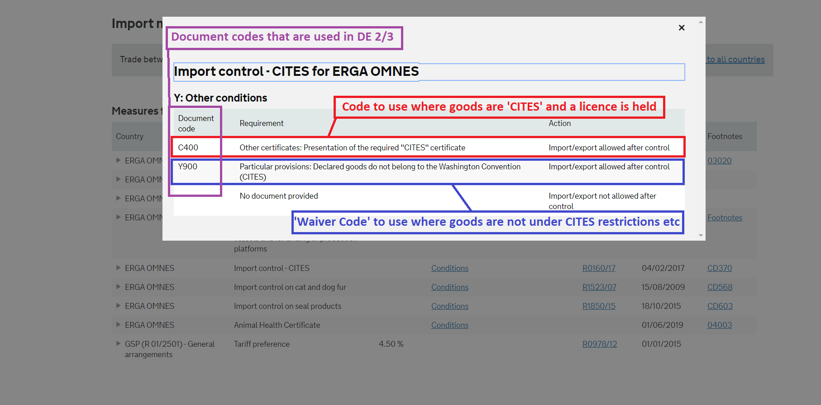
Selecting ‘Conditions’ on the ‘Import Control – CITES’ row

Slide 9
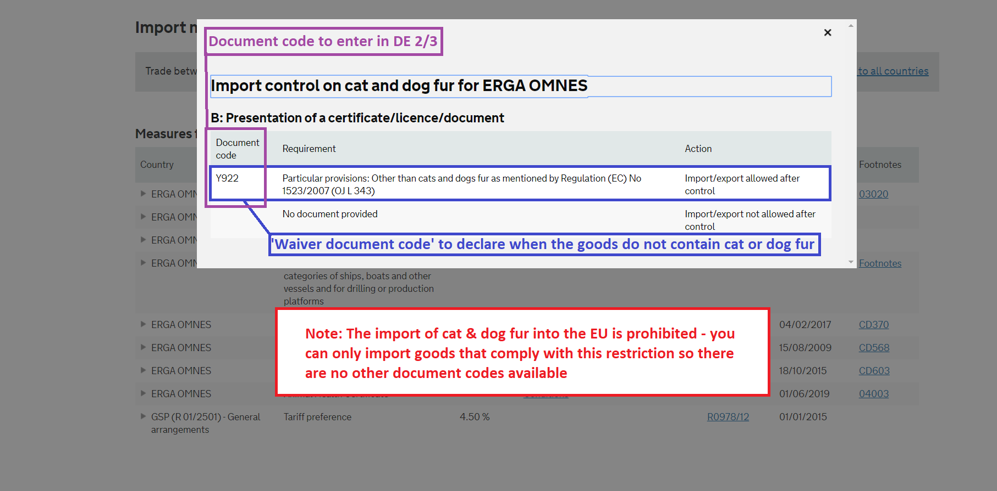
Selecting ‘Conditions’ on the ‘Import Control on cat and dog fur’ row

Slide 10
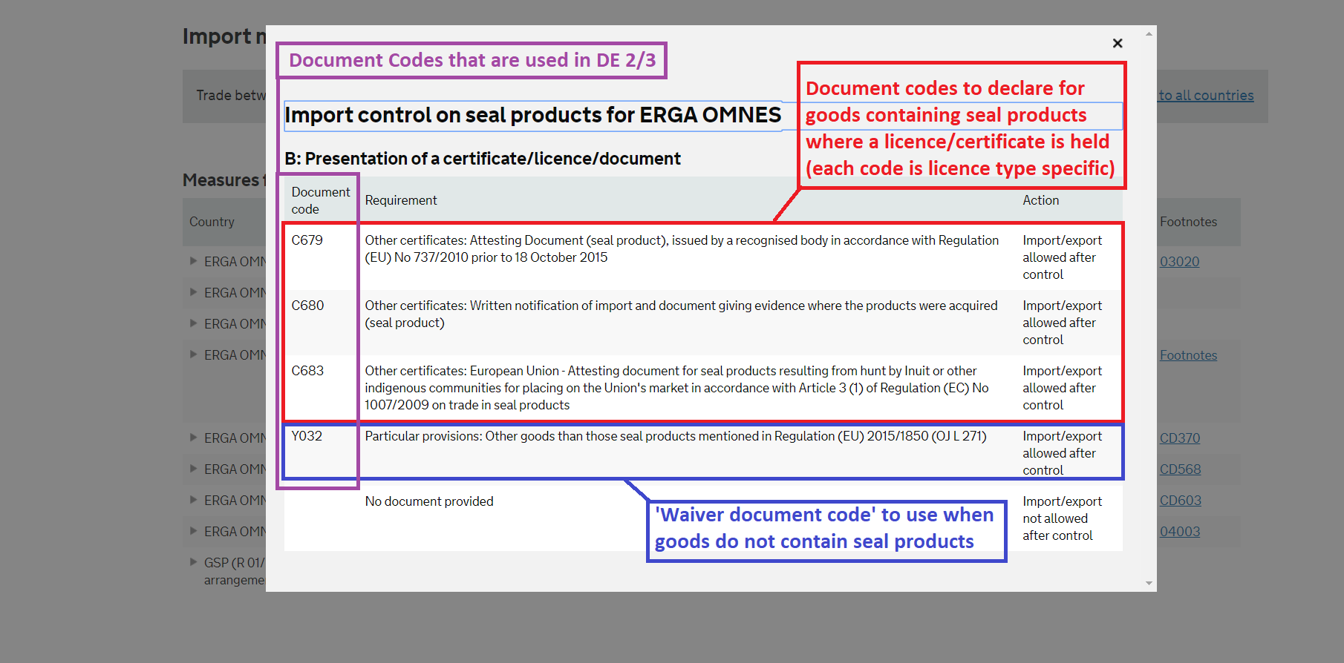
Selecting ‘Conditions’ on the ‘Import Control on seal products’ row

Slide 11
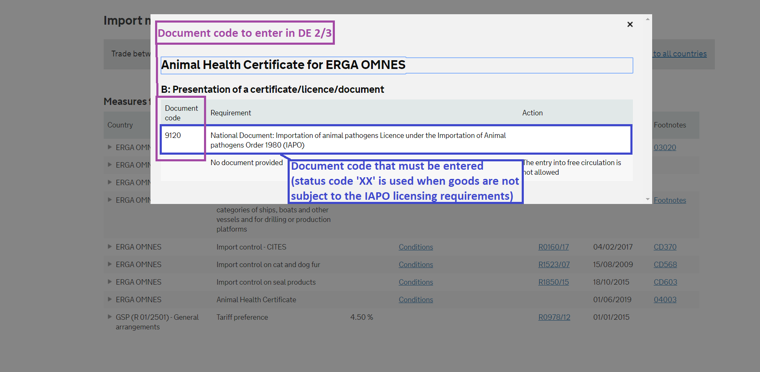
Selecting ‘Conditions’ on the ‘Animal Health Certificate’ row

